Slide 1
Video-over-IP
Unified!!
October, 2012

Slide 2
Video Over IP
The world has evolved
But, where is the value
for the customer?

Slide 3
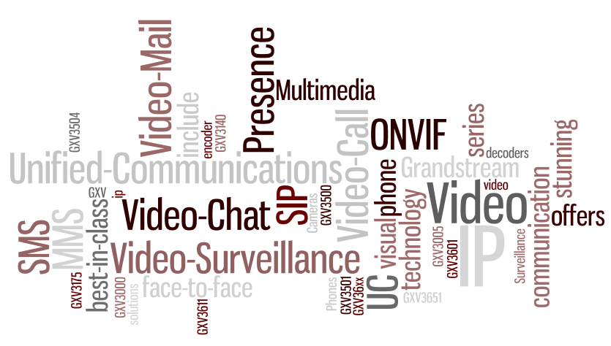
Video Over IP
Video Calls
Video Surveillance
SIP
Video Mail
ONVIF
Unified Communications
Video Clips
A complex mix of offers, features and technology

Slide 4
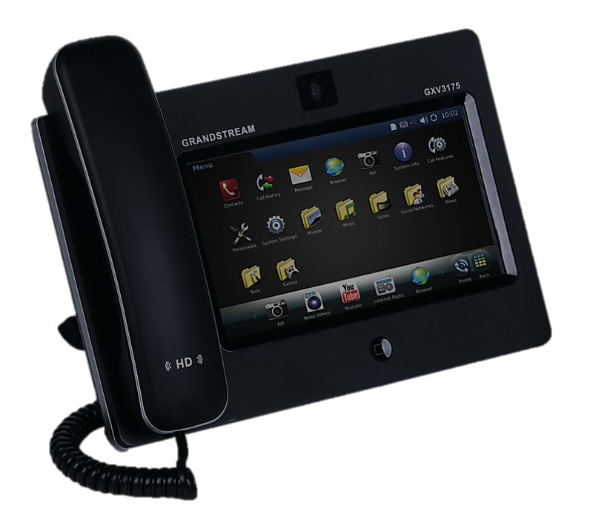
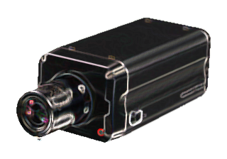
Video Over IP
Video Surveillance as part of the UC Space
Background
Video Surveillance end-point today
UC and Telephony Related Applications
* Infonetics Research
**Allied Business Intelligence, Inc., http://www.abiresearch.com/press/1081
***IMS Research,

Slide 5
Video Over IP
Bringing a new component into
the Unified Communications Space:
By 2012, 80% of survey respondents plan to use video as part of their unified communications architecture*
Video Surveillance market to reach $46billion in 2013**
IP cameras will claim 42% of worldwide market by 2013***
Video Surveillance Cameras in the cloud allow extended application for the customer** (VSaaS)
* Infonetics Research
**Allied Business Intelligence, Inc., http://www.abiresearch.com/press/1081
***IMS Research,

Slide 6
Video Over IP
Two different Industries sharing technological advances
Video Telephony
Video Surveillance
H.264, G.711, etc
MPEG
SIP Protocol
ONVIF
SIPS/TLS/SRTP
Video Analytics
Multistream
Multiuser
Remote Provisioning

Slide 7
Video Over IP
Video Surveillance Terminal - IP Camera/DVS
Moving into the UC Space
CCTV Camera
Analog Video
B&W / Color
Zoom
PTZ
420/520/580 TVL
Day/Night Vision

Slide 8
Video Over IP
Video Surveillance Terminal in the UC Space
PoE
Digital Zoom
Analog Video
IP/HTML
Surveillance Camera
B&W / Color
Zoom
HD
420/520/580 TVL
PTZ
Day/Night Vision
Audio
H.264/MPEG
Multiuser
Video Analitics

Slide 9
Video Over IP
Video Surveillance Terminal in the UC Space
Video Analitics
PoE
Digital Zoom
Analog Video
HD
HTML/ONVIF
Surveillance Camera
B&W / Color
Audio
Zoom
H.264/MPEG
420/520/580 TVL
Multiuser
SIP
PTZ
Day/Night Vision
2 Way Audio
Multistream
DTMF
Storage
I/O Contacts
Email

Slide 10
Video Over IP
Video Surveillance Terminal in the UC Space
Video Analitics
IP-Video
(UC Module)
Surveillance Camera
Analog Video
PoE
HD
MPEG
Zoom
Digital Zoom
Multiuser
PTZ
Day/Night Vision
2 Way Audio
Multistream
Bringing together complex
high-end features
Storage
DTMF
I/O Contacts
Email

Slide 11
Video Over IP
Video Surveillance Terminal in the UC Space
IP-Video
(UC Module)
Surveillance Camera
DVS
IP-Video
(UC Module)
Bringing together complex
high-end features

Slide 12
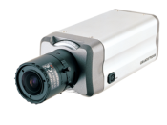
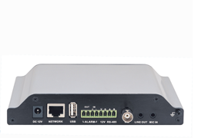
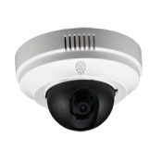
Video Over IP
Video Surveillance Terminal in the UC Space
IP Cameras
Video Eoncoders
Bringing together complex
high-end features

Slide 13
Video Over IP
Just to name few features from each segment:
UC Platform
VMS
(Video Management System)
PBX Features
Video Analytics
Presence
Monition Detection
IM, MMS
Recording/Review
Follow/Find me
Alarm control
VVW Conferencing
PTZ control
CRM
I/O Control
And More
And More

Slide 14
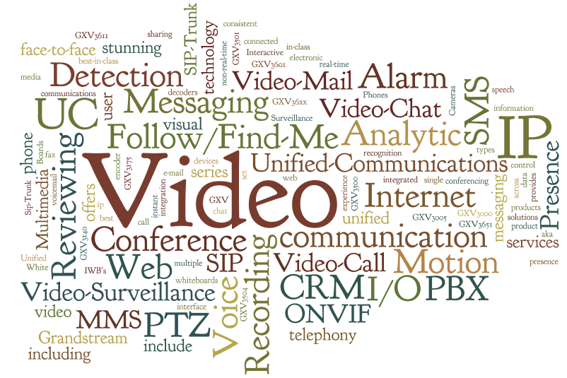
Video Over IP
Merging UC + VMS will require a good sense of what represents value

Slide 15
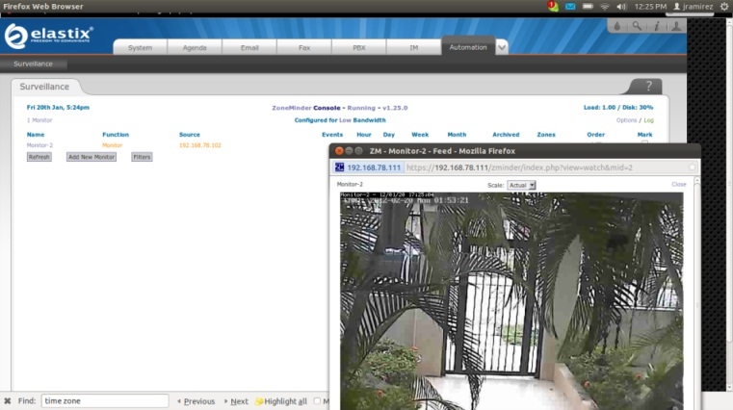
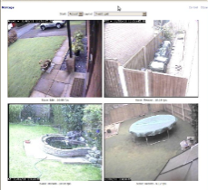
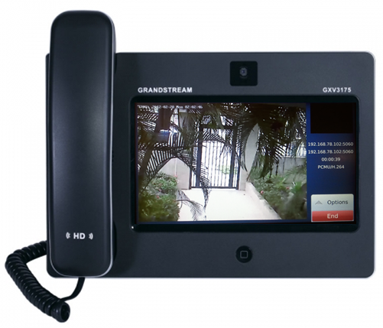
Video Over IP
Few Examples
Elastix UC Platform
IP Video Call support
ZoneMinder Integration
Recording/Review Capabilities
Alarm Control
Video Analitics
IP-Camera Autoprovision
GXV3175

Slide 16
Video Over IP
Few Examples
Epigy Quadro:
IP Video Call support
IP-Camera IOT
Recording/Review Capabilities
Panic Button integration
Remote Office
Video Conferencing

Slide 17
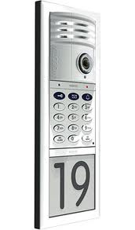
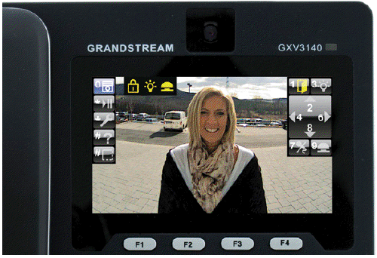
Video Over IP
T24
Few Examples
Mobotix-Grandstream Integration
Vendor IOT
SIP Based
H.264 Compression
Surveillance Application over pure IP-PBX SIP Based Platform
Recording/Review Capabilities
GXV3140

Slide 18
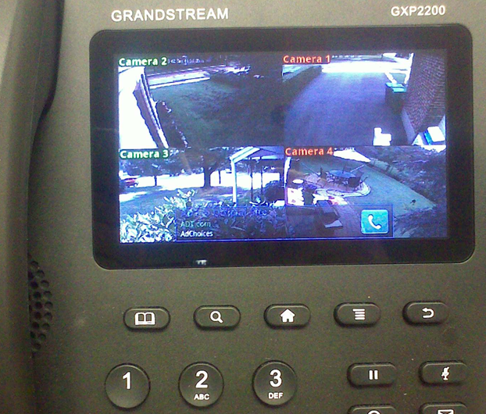
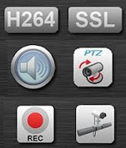
Video Over IP
Few Examples
Video Surveillance at the desktop
GXP2200

Slide 19
Thank you !!!
Jorge Otero – jotero@grandstream.com
+1-617-566-9300 x 814
Notes:
使用

